Slide 1

Viterbi Career Services
Presented By:
Viterbi Career Services

Slide 2
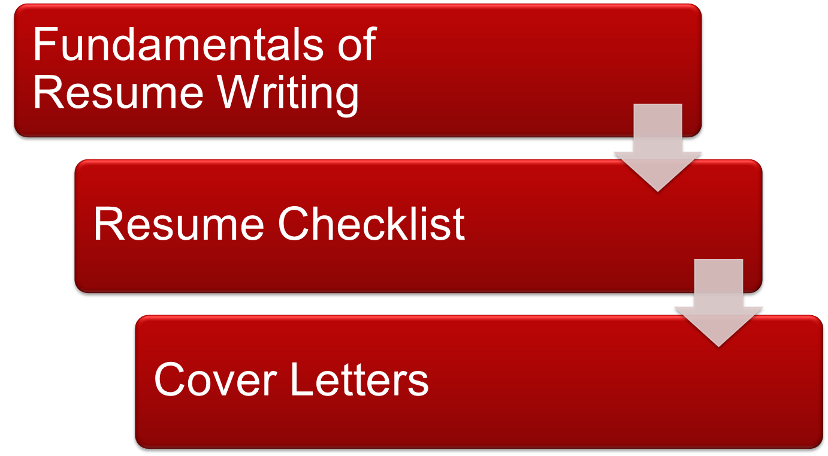
Workshop Overview

Slide 3
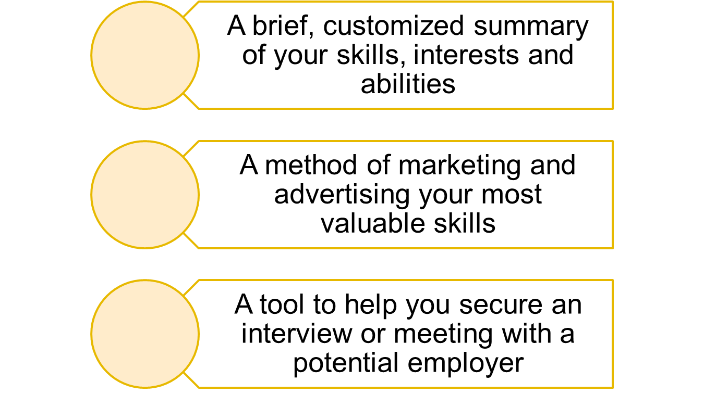
What is a Resume?

Slide 4
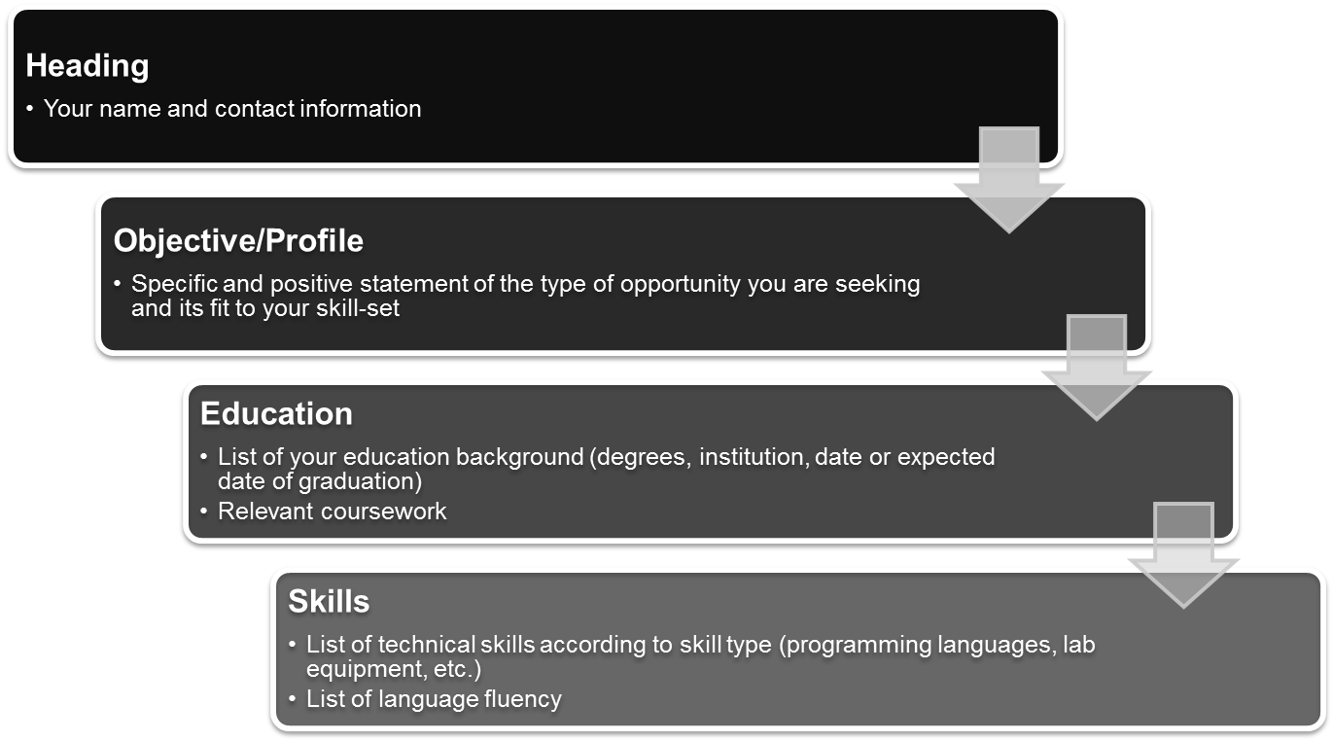
Purpose of a Resume
Resume Sections

Slide 5
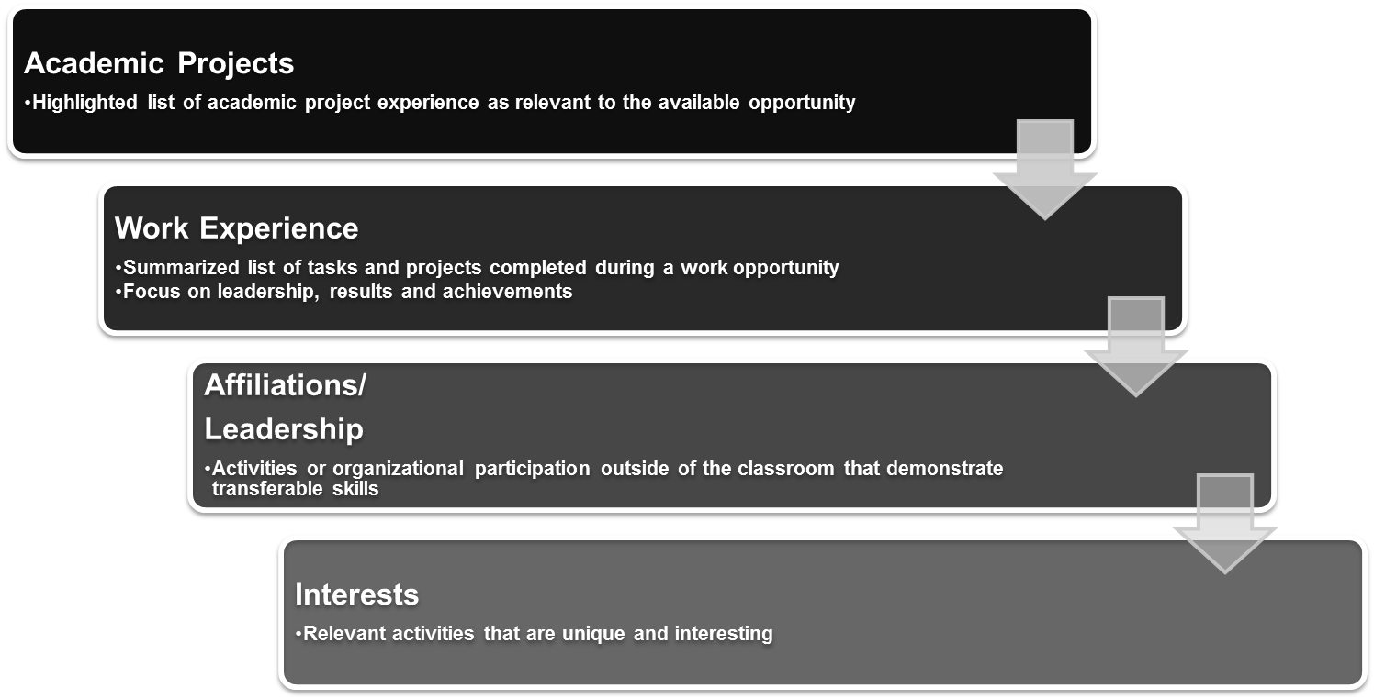
Purpose of a Resume
Resume Sections

Slide 6
Resume Basics
Header
Includes Name, Address, Phone Number and Email
Tommy Trojan
555 Omaha Lane, Apt. B
Los Angeles, CA 90089
213-740-1111
ttrojan@usc.edu
Jane Bovard
3650 McClintock Ave 213-555-5555
Los Angeles, CA 90089 sharaz@hotmail.com
Josephine Bruin
3550 Hilgard Ave ◦ Los Angeles, CA 90095 ◦ 213-555-5555 ◦ cutiepie@yahoo.com

Slide 7
Objective/ Profile
What types of positions are you seeking?
Seeking a challenging position at a growth-oriented organization.
Seeking a summer internship in biomedical engineering.
Seeking a summer internship in technical support to apply my interpersonal skills and two years professional experience in customer service.

Slide 8
Education
Example:
MS in Electrical Engineering GPA: 3.2
University of Southern California Expected 5/2014
Los Angeles, CA
BS in Electrical Engineering GPA: 3.5
University of Southern California Expected 5/2012
Los Angeles, CA
Relevant Coursework:
Mixed-Signal Integrated Circuit Design Linear Control Systems
Optical Fiber Communications Systems Principles of Radar

Slide 9
Skills
Highlight tools and languages unique to your skill set
Technical Skills
  Programming Languages, Software Applications, Lab Equipment
Language Proficiency (verbal)

Slide 10
Work Experience
Office Assistant Sept 2011 – Present
USC Engineering Student Affairs
Data Entry
General Office Tasks
Office Assistant Sept 2011 – Present
USC Engineering Student Affairs
Update and maintain Access database of student records
Schedule appointments for 8 advisors
Respond to phone and in-person inquiries

Slide 11
Academic Projects
Cargo Plane Completion Fall 2011
Team Member
Designed, built and tested prototype aluminum wheels
Helped build carbon fiber fuselage and foam tail glass with fiberglass skin
Ozone Flight Sampler Fall 2011
Team Leader
Collaborated with a team on the thermal design of reciprocating engine and rocket propulsions
Optimized properties in order to reach upper stratosphere

Slide 12
Activities
What organizations and activities utilize your time?
Professional engineering organizations a must!
Campus & community involvement
Stress leadership roles in organized activities
Interests should be UNIQUE & INTERESTING

Slide 13
Resume Checklist
◻ Proofread for grammar and spelling!
Make sure your resume is easy to scan by the human eye and online bots
Font size between 11 to 12 point
Use bullet points to identify accomplishment statements
Consistency in formatting
One page resume
Adjust margins between .5 to 1 inches
Use white or off white resume paper – very positive and professional
Avoid templates (MS Word resume templates)

Slide 14
Resume Checklist
◻ Do not exaggerate and BE HONEST
Delete unnecessary information – keep it relevant!
Watch tenses and utilize action verbs
Do not use the same examples for academic projects and work experience. Variety will maintain interest
By the way… PROOFREAD!

Slide 15
Cover Letters Broken Down
Three Parts:
The Introduction
The Body
  No more than two paragraphs
Conclusion
Notes:
HAVE COVER LETTER HANDOUT TO REVIEW
The Intro
Tell the reader why you are contacting them
Mention the desired job and your connection with that person (if applicable)
Briefly mention your background in one sentence
The goal is to make the reader interested in reading further!
The Body
Describe how your skills match the position’s requirements
Why are you the best candidate for the job?
What interests you about the company?
What unique skills can you offer the company?
Conclusion
Express interest in the position
Briefly summarize your combination of skills and abilities
Let them know how they can contact you – phone and email
Thank the reader for their time!

Slide 16
Cover Letter Sample
Bob Smith
Project Manager
ABC Company
123 Main Street
Anytown, CA 12345 January 1, 2012
Dear Mr. Smith,
I am writing to apply to the Engineering Intern position (#4454) posted on ABCcareers.com. I am certain that my engineering experience plus my passion for the Electrical Engineering industry makes me a strong candidate for this position.
Currently I am an Electrical Engineering graduate student at the University of Southern California where I have been able to take part in several class projects. I was a team leader for a socket programming project in which we simulated a chat group environment using a bootstrap server, content provider and multiple clients. I have also been involved outside of academics as a Corporate Liaison with the Viterbi Graduate Student Association (VGSA) where I organized and implemented social and educational activities. The involvement with the VGSA has contributed to the growth of my communication skills and growth as a leader which I know would transfer well to the opportunity. Last summer, I interned with XYZ Company and was exposed to many of the functions you require for this position including example, example and example. This experience allowed me to build and strengthen my technical skills while contributing to the company goals.
Please find a detailed description of my educational and professional history on my attached resume. I look forward to learning more about this internship at ABC Company and how I can add value to your team. I can be reached at (213) 555-1234 or tommytrojan@usc.edu
Thank you for your time and consideration.
Sincerely,
Tommy Trojan
Include a standard letter heading
Or “Dear Hiring Manager” if you don’t know
Mention the position, where you found it, why you are a fit
Call out key points that relate to the job description
Mention your resume, enthusiasm, and contact info

Slide 17
Exercise
Writing an Accomplishment Statement

Slide 18

Questions?

